Slide 1
Connectionist Computing
COMP 30230/41390
Gianluca Pollastri
office: CASL, ground floor Science East.
email: gianluca.pollastri@ucd.ie
Connectionist Computing COMP 30230

Slide 2



Credits
Geoffrey Hinton, University of Toronto.
  borrowed some of his slides for “Neural Networks” and “Computation in Neural Networks” courses.
Ronan Reilly, NUI Maynooth.
  slides from his CS4018.
Paolo Frasconi, University of Florence.
  slides from tutorial on Machine Learning for structured domains.
Connectionist Computing COMP 30230

Slide 3
Lecture notes on Moodle
https://csmoodle.ucd.ie/moodle/course/view.php?id=288
Strictly confidential...
Enrolment key: 30230cc
Connectionist Computing COMP 30230

Slide 4
Books
No book covers large fractions of this course.
Parts of chapters 4, 6, (7), 13 of Tom Mitchell’s “Machine Learning”
Parts of chapter V of Mackay’s “Information Theory, Inference, and Learning Algorithms”, available online at:
http://www.inference.phy.cam.ac.uk/mackay/itprnn/book.html
Chapter 20 of Russell and Norvig’s “Artificial Intelligence: A Modern Approach”, also available at:
http://aima.cs.berkeley.edu/newchap20.pdf
More materials later..
Connectionist Computing COMP 30230

Slide 5
Marking
3 landmark papers to read, and submit a 10-line summary on Moodle about: each worth 6.67%
a small connectionist tool to build and play with: 30%
Final exam: 50%
Connectionist Computing COMP 30230

Slide 6
Programming assignment
Implement a Multi-Layer Perceptron, test it.
The description on Moodle.
Submit through Moodle code and test results by April the 28th at 23:59, any time zone of your choice (Baker Island?).
30% of the overall mark
One third of a grade down every day late, that is: if you deserve an A and you’re 1 day late you get an A-, 2 days late a B+, etc.
Connectionist Computing COMP 30230

Slide 7
Assignment 2
Read the paper “Finding structure in time”, by Elman (1990), up to and excluding the Discovering the notion "word" section.
The paper is on Moodle.
Submit a 250 word MAX summary by April the 4th at 23:59 on Moodle, any time zone of your choice (Baker Island?).
5% of the overall mark
1/3 of a grade down every day late, that is: if you deserve an A and you’re 1 day late you get an A-, 2 days late a B+, etc.
You are responsible for making sure I get it..
Connectionist Computing COMP 30230

Slide 8
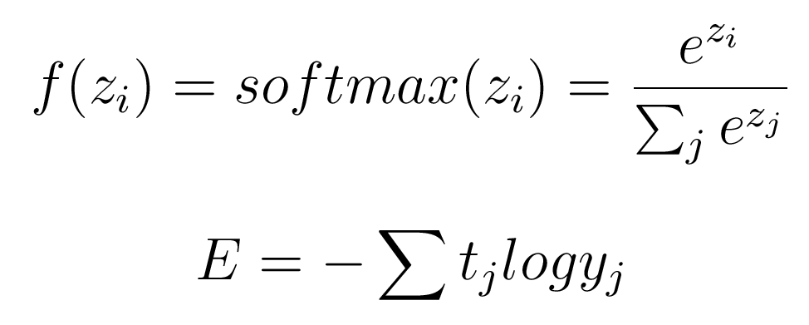
Alternatives: softmax and relative entropy
Non-local non linearity.
Outputs add up to 1 (can be interpreted as the probability of the output given the input).
Connectionist Computing COMP 30230

Slide 9
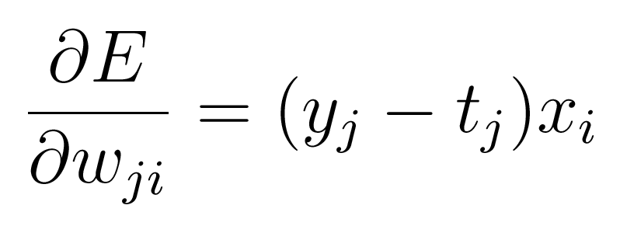
Gradient descent with softmax
No f’() : the steepness of the cost function balances the flatness of the output non-linearity.
Connectionist Computing COMP 30230

Slide 10
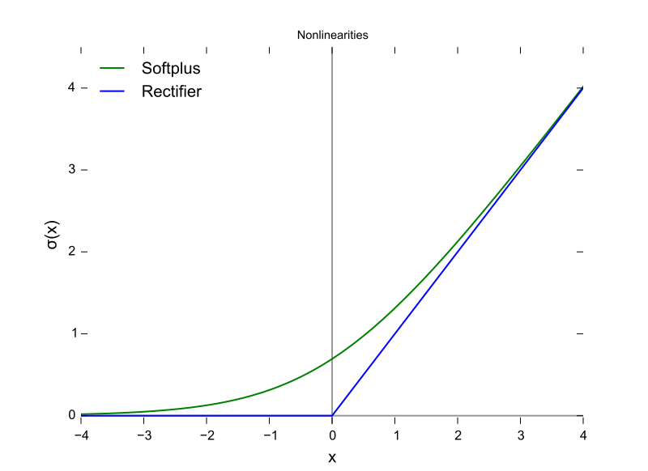
More squashing functions
ReLU
Smooth ReLU
Also: Leaky ReLU, parametric ReLU, ..
Deep Learning

Slide 11
Learning and gradient descent problems
Overfitting (general learning problem): the model memorises the examples very well but generalises poorly.
GD is slow... how can we speed it up?
  GD does not guarantee that the direction of maximum descent points to the minimum.
  Sometimes we would like to run where it’s flat and slow down when it gets too steep. GD does precisely the contrary.
Local minima?
Connectionist Computing COMP 30230

Slide 12
Overfitting
The training data contains information about the regularities in the mapping from input to output. But it also contains noise
  The target values may be unreliable.
  There will be accidental regularities just because of the particular training cases that were chosen.
When we fit the model, it cannot tell which regularities are real and which are caused by sampling error.
  So it fits both kinds of regularity.
  If the model is very flexible it can model the sampling error really well. This is a disaster.
Connectionist Computing COMP 30230

Slide 13
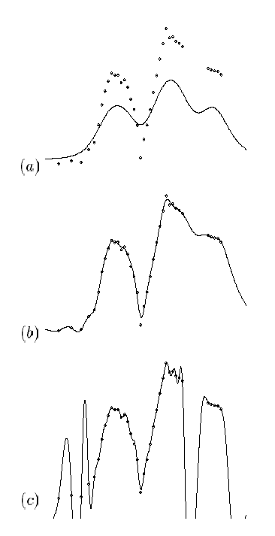
Overfitting
a) can’t fit the examples well enough.
b) looks great.
c) fits all points even better than b) but isn’t the easiest hypothesis.
Connectionist Computing COMP 30230

Slide 14
Overfitting: formally
A learner overfits the data if
  It outputs a hypothesis h(⋅)∈H having true error ε and empirical error E, but
  There is another h’(⋅)∈H having
  E’>E and ε’ < ε
In practice, during learning the error on the training examples decreases all along, but the error in generalisation reaches a minimum and then starts growing again.
Connectionist Computing COMP 30230

Slide 15
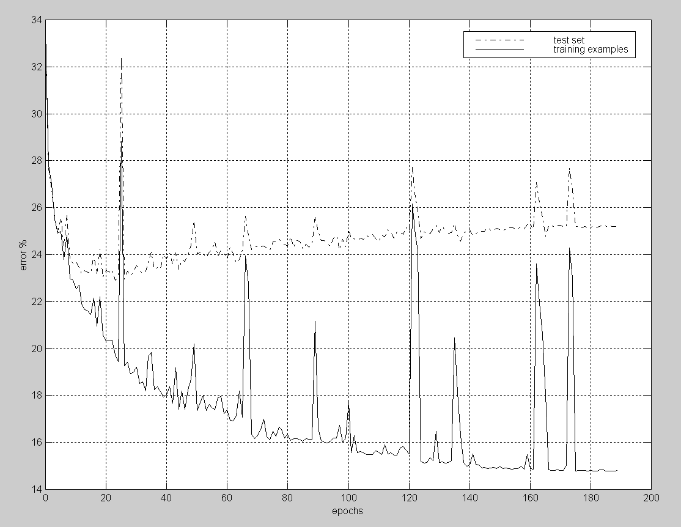
Connectionist Computing COMP 30230

Slide 16
Ways to prevent overfitting
Use a model that has the right capacity:
  enough to model the true regularities
  not enough to also model the spurious regularities (assuming they are weaker).
  problem: how do we know which regularities are real?
Standard ways to limit the capacity of a neural net:
  Limit the number of hidden units.
  Limit the size of the weights.
  Stop the learning before it has time to overfit.
Connectionist Computing COMP 30230

Slide 17
Limiting the size of the model: using fewer Hidden Units
If n=number of inputs and M=number of hidden units the VC of a MLP is proportional to (n M logM).
Reducing M reduces the capacity of the model -> prevents overfitting.
Of course we need to know the exact capacity we need. Too many weights: overfitting. Too few weights: underfitting.
In practice: trial and error.
Connectionist Computing COMP 30230

Slide 18
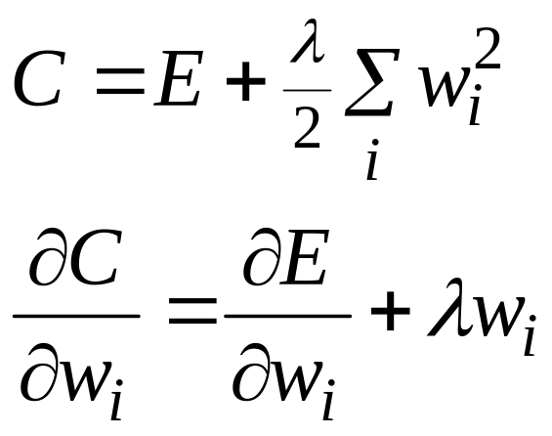
Limiting the size of the model: weight decay
Weight-decay involves adding an extra term to the cost function that penalises the squared weights.
  Keeps weights small unless they have large error derivatives.
Connectionist Computing COMP 30230

Slide 19
Weight decay
It prevents the network from using weights that it does not need.
It tends to keep the network in the linear region, where its capacity is lower.
This helps to stop it from fitting the sampling error. It makes a smoother model in which the output changes more slowly as the input changes.
It can often improve generalisation a lot.
Connectionist Computing COMP 30230

Slide 20
Weight decay as regularisation
Weight decay is a form of regularisation.
Many other forms of it may be devised, all of which have the same basic aim (prevent the model from overfitting).
The difference between them is what function we use to penalise large weights.
Connectionist Computing COMP 30230

Slide 21
Preventing overfitting: early stopping
If we have lots of data and a big model, it’s very expensive to keep re-training it with different amounts of weight decay.
It is much cheaper to start with very small weights and let them grow until the performance in generalisation starts getting worse.
The capacity of the model is limited because the weights have not had time to grow big.
Connectionist Computing COMP 30230

Slide 22
Overfitting in MLP
y_{i}
Start learning with small weights (symmetry breaking)
The mapping X→Y is nearly linear: number of effective free parameters (and VC-dim) nearly as in SL perceptron
As optimisation proceeds hidden units tend to get out of the linear region, increasing the effective number of free parameters
A variable-size hypothesis space
h_{j}
Connectionist Computing COMP 30230

Slide 23
Stop here
Connectionist Computing COMP 30230

Slide 24
Model selection
How do we decide which model is the best? How do we decide when we have the right capacity?
We can use test data. A problem though is that we get an unfair prediction of the error rate we would get on new test data.
So use a separate validation set to do model selection.
Connectionist Computing COMP 30230

Slide 25
Sets
Divide the total dataset into three subsets:
  Training data is used for learning the parameters of the model.
  Validation data is not used for learning but is used for deciding what type of model and what amount of regularisation works best.
  Test data is used to get a final, unbiased estimate of how well the network works. We expect this estimate to be worse than on the validation data.
We could then re-divide the total dataset to get another (or more than one) unbiased estimate of the true error rate. N-fold Cross-Validation.
Connectionist Computing COMP 30230

